Slide 1


Slide 2

Good Morning, Bengaluru

Slide 3
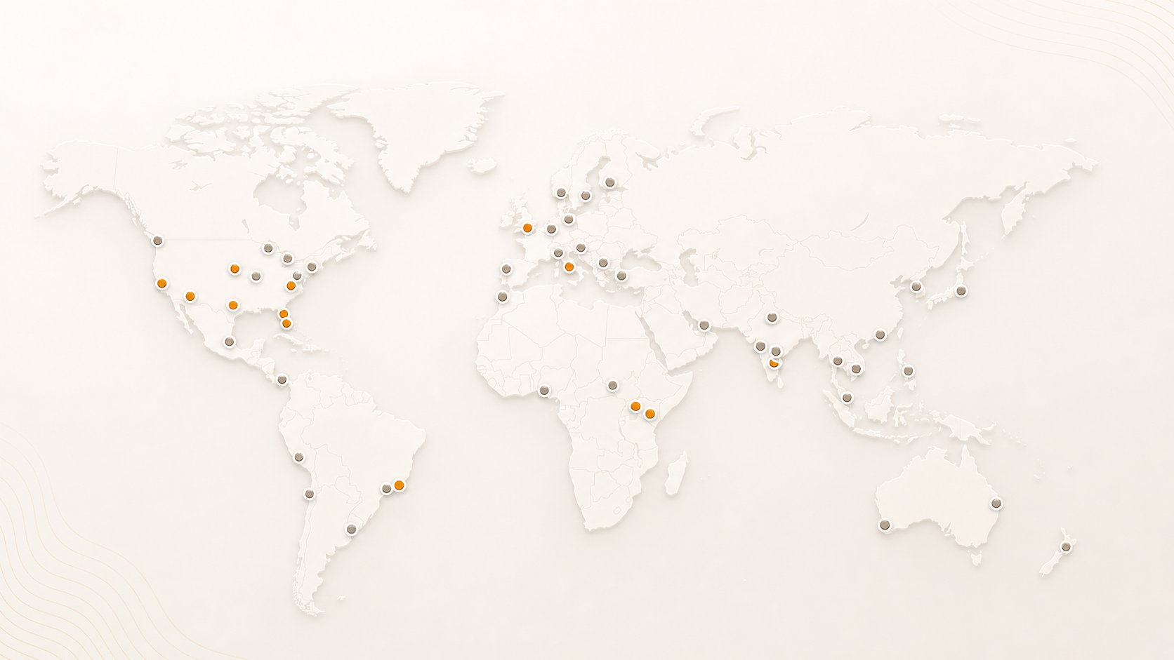
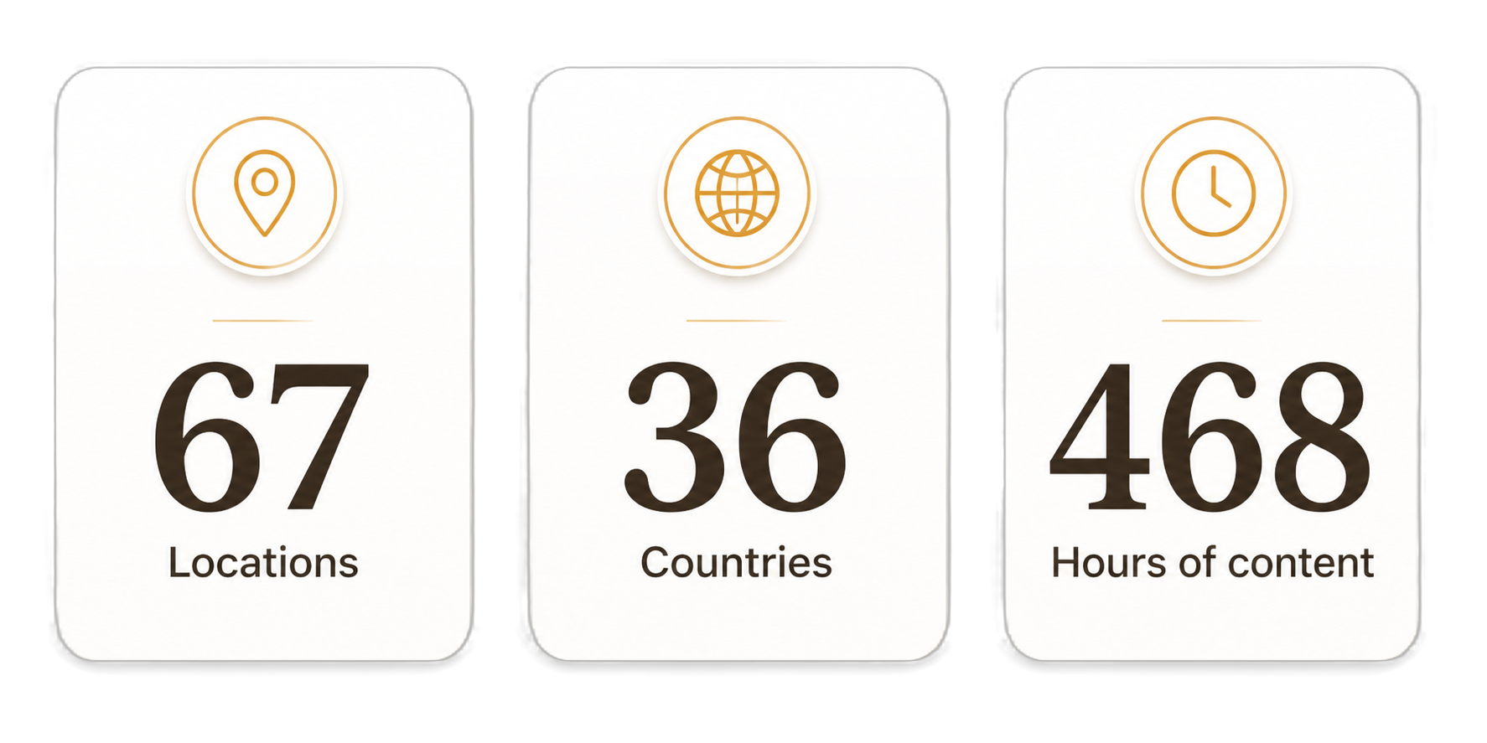
AgentCon around the world

Slide 4
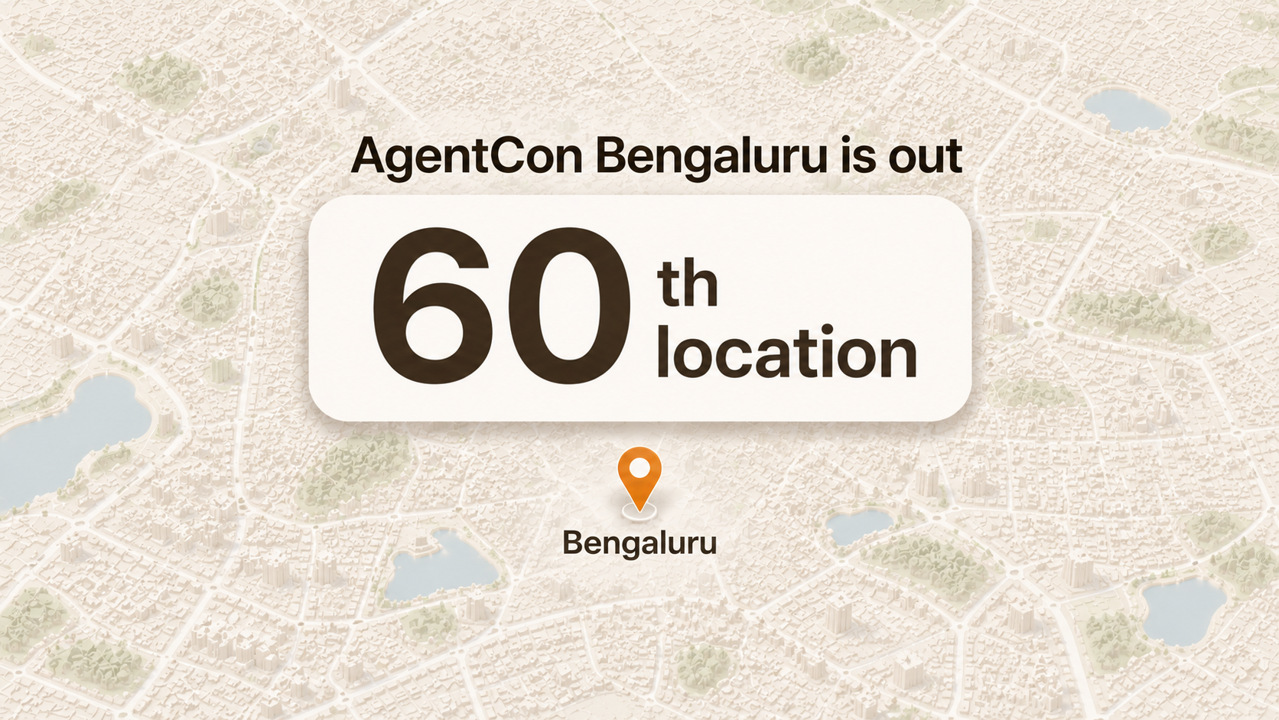

Slide 5


Slide 6
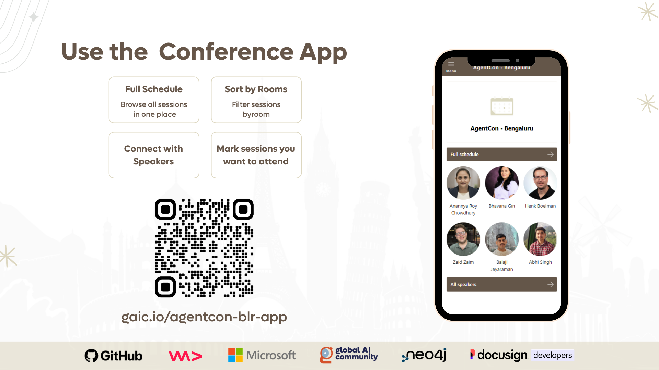

Slide 7
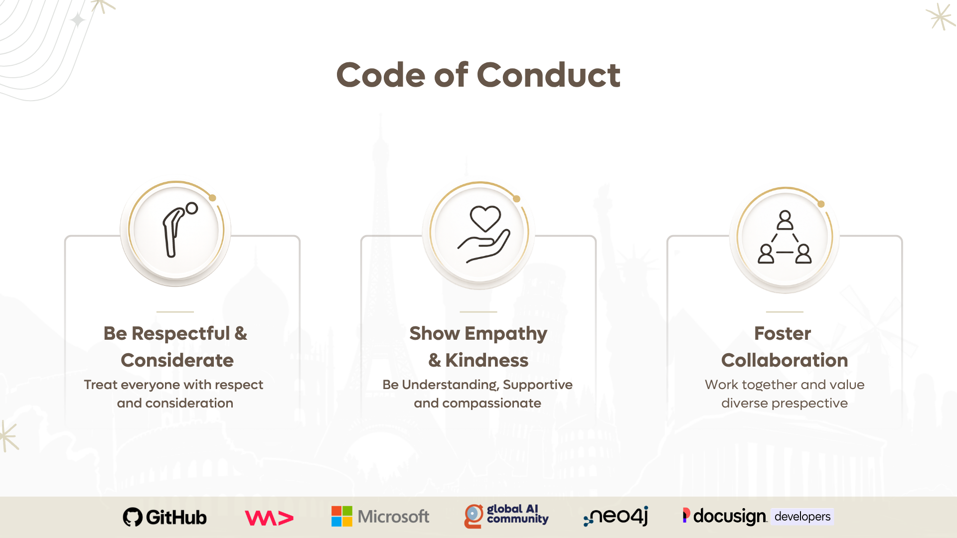

Slide 8
09:00 AM – 10:00 AM
Credentials + Welcome Coffee
Keynote: Henk Boelman
Agents of Tomorrow: Building the Next Generation of Intelligence
10:00 AM - 10:55 AM
11:00 AM- 12:25 PM
Sessions
12:30 PM - 01:25 PM
Lunch Break
01:30 PM - 04:00 PM
Sessions
04:30 PM - 05:00 PM
Closing Remarks

Slide 9

Join the AI Conversation on Discord
gaic.io/discord

Slide 11
09:00 AM – 10:00 AM
Credentials + Welcome Coffee
Keynote: Henk Boelman
Agents of Tomorrow: Building the Next Generation of Intelligence
10:00 AM - 10:55 AM
11:00 AM - 12:25 PM
Sessions
11:00 AM - 12:30 PM
Workshop
12:30 PM - 01:30 PM
Lunch Break
01:30 PM - 03:00 PM
Sessions
01:30 PM - 03:00 PM
Workshop
03:00 PM - 03:30 PM
Coffee Break
03:30 PM - 04:30 PM
Session
04:30 PM - 05:00 PM
Closing Remarks

